Slide 1

A PRESENTATION ABOUT THE
“NEW ECONOMIC POLICY AND MNCs”
Dr. Srinibash Dash
Associate Professor & Head
School of Management
GMU, SBP

Slide 2
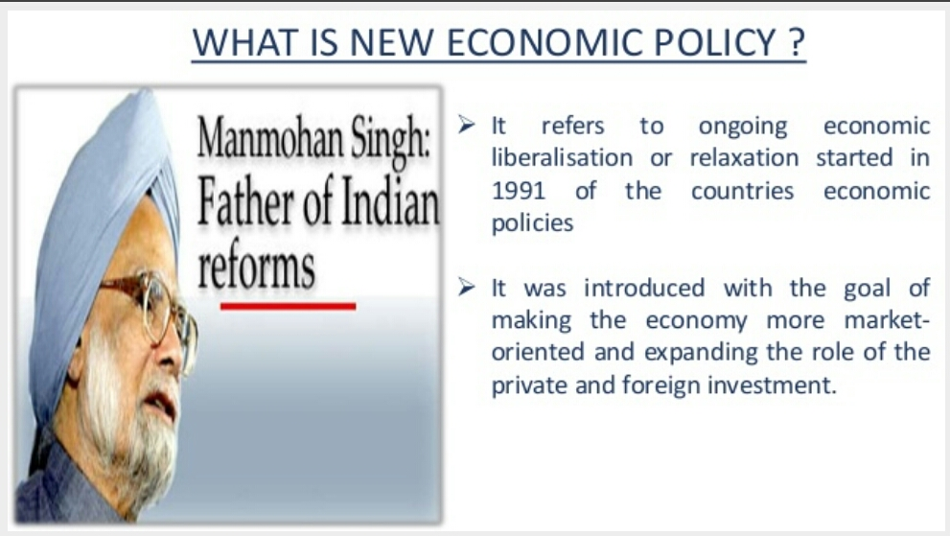

Slide 3
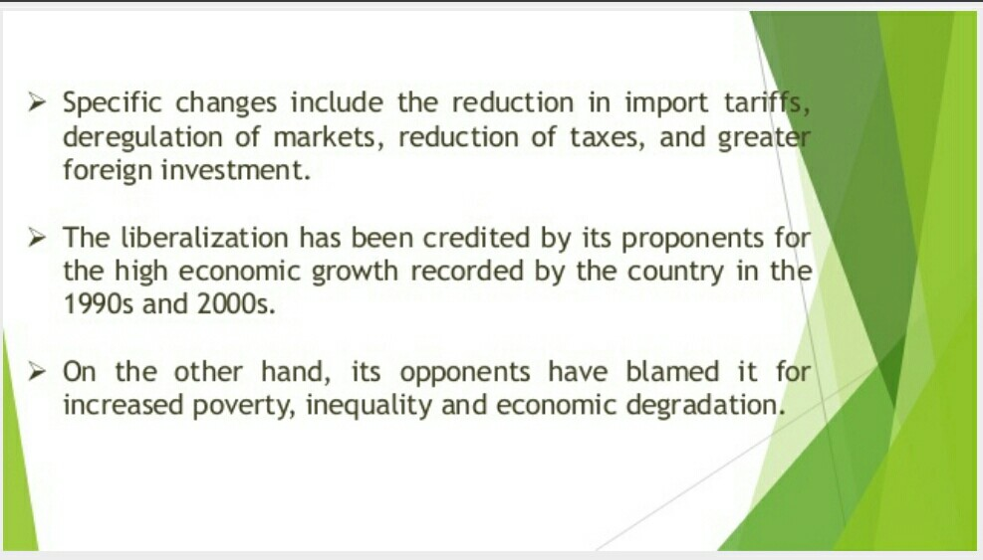

Slide 4
OBJECTIVES OF 1991 POLICY :
To unshackle the Indian Industrial Economy from the bureaucratic economy .
To introduce liberalisation with a view to integrate the Indian economy with the world economy .
To remove the restrictions on FDI as also free the domestic entrepreneur from the restrictions of MRTP .
The policy aimed to shed the load of the public enterprises which have shown a very low rate of return .
Liberalising the industry from the regulatory devices .
Ensuring running of public enterprises on business lines and thus cutting their losses .
Providing more incentives for industrialisation of backward areas .
Ensuring rapid industrial development in a competitive environment .

Slide 5
TYPES OF ECONOMIC POLICY:-
There are 3 types of economic policies and they are as explained below precisely :
INDUSTRIAL POLICY : It refers to the Government policy towards the establishment , working and management of industries in the country . It is a comprehensive term covering all those principles , procedures and regulations which control the industrial undertakings of a country . It reflects the Government’s attitude towards public and private sectors , foreign capital and technology etc .
MONETARY POLICY : It refers to the policy regarding money supply and bank credit in the country . I t is formulated and announced by the central bank of the country (RBI) and implemented thorough a wide network of commercial banks and other financial institutions . It is necessary to regulate money supply and bank credit in a country so as to ensure proper functioning of the economy .
FISCAL POLICY : It refers to the Government policy which is concerned with raising public revenue through taxation and other means and deciding on the level and pattern of public expenditure . It is reflected in the annual budgets of the country .

Slide 6
COMPONENTS OF ECONOMIC POLICY :
There are 3 major components of new economic policy :
LIBERALISATION : Liberalising the economy against unnecessary controls and regulation . It abolished the system of industrial licensing except 8 industries . There is freedom in fixing the prices of goods and services . Emphasis to be on controlling and regulating monopolistic , restrictive and unfair trade practices .
PRIVATISATION :It is widening the scope and role of private sector . It lead to the introduction of private ownership in public owned units . There is greater participation of private individuals . 55% of the contribution is made by the private sector for the development of country . It also refers to giving greater role to private sector and reducing the role of public sector .
GLOBALIZATION : It refers to the integration of various economies of world . Till 1991 Indian Government was following strict policy in regard to import and foreign investment in regard to licensing of imports , tariff , restrictions etc. But after new policy government adopted policy of globalisation by importing liberalisation , adoption of export duty etc .

Slide 7
EFFECTS OF ECONOMIC POLICY
NEGATIVE
POSITIVE
Increase in GDP growth rate
Increase in foreign direct investment
Increase in foreign exchange
Increase in per capita income
Increase in foreign trade
Increase mobility of factor of production
Outsourcing
Growing unemployment
Neglect of agriculture
Growing personal disparities
Infrastructural inadequacies
Wide spread poverty
Demonstration effect
Indian small scale industries badly affected

Slide 8
What is a Multinational Company?
It is a company that manages production or deliver services in more than one country.
According to Franklin Root (1994), an MNC is a parent company that:
Engages in foreign production through its affiliates located in several countries,
Exercises direct control over the policies of its affiliates,
Implements business strategies in production,marketing,finance staffing that transcend national boundaries.

Slide 9
ADVANTAGES OF MNCs
To the
Host
country
To the home country

Slide 10
Advantages of MNCs to the Host country:-
Transfer of technology,capital and entreprenuership.
Increase in the investment level and thus, the income and employment in the host country.
Greater availability of products for local consumers.
Increase in exports and decrease in imports.

Slide 11
Advantages to Home country:-
Acquisition of raw materials from abroad.
Technology and management expertise acquired from competing in global markets.
Export of components and finished goods for assembly or distribution in foreign markets.
Inflow of income from overas profits, royalties and management contracts.

Slide 12
MULTI NATIONAL COMPANIES RELATED WITH NEW ECONOMIC POLICY :
Multi-National companies investment in the developing world opens up new horizons for economic development and for economic strategy .
New horizons for cost savings and revenue generation are opening up for multi national companies .
Multinational companies are well positioned to transfer their competitive products and processes but less equipped to tailor them appropriately to local conditions .
Going global is obviously not a recipe for success in and of itself .
The single biggest effect evidenced was the improvement in the standard of living of the country’s population .
The impact on employment was either neutral or positive in two-thirds of cases .
Improved productivity and output in the sector and contributed to increasing national income .

Slide 13
CONCLUSION :
At last a question arises why new economic policy , 1991 ? The answer to this question is that:
The Indian currency , the rupee was inconvertible and high tariffs and import licensing prevented foreign goods reaching the market .
India also operated a system of central planning for the economy , in which firms required licences to invest and develop .
It was started by the government of India in 1991 for taking the country out of economic difficulty and speeding up of the development of the country .
The centre of economic reform has been liberalisation , privatisation and globalisation .

Slide 14
THANK YOU

